Slide 1
Subspace Learning Machine

Slide 2
Motivation
Inspired by Support Vector Machine (SVM), Decision Tree (DT), Multilayer Perceptron (MLP), and Extreme Learning Machine (ELM)

Slide 3
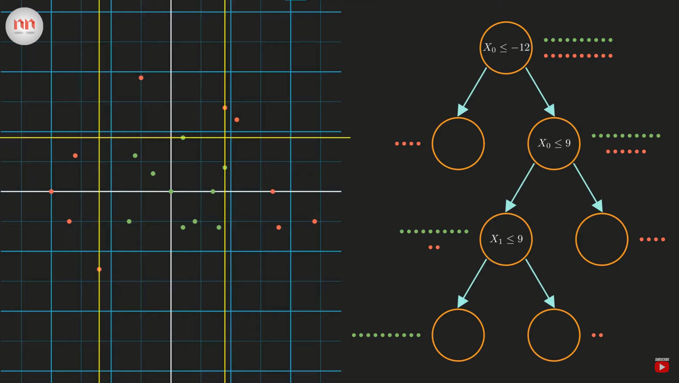

Slide 4
Methodology
Use the probabilistic projections of features to yield 1D subspaces
Partition the feature space with hyperplanes
Assign the original feature space as the root node and the subspaces as the child nodes
Recursively apply partitioning process to the child nodes
Ensemble learning (SLM forest, SLM boost)

Slide 5
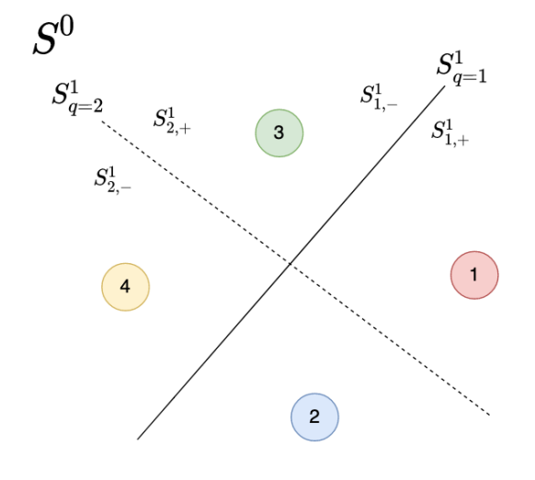
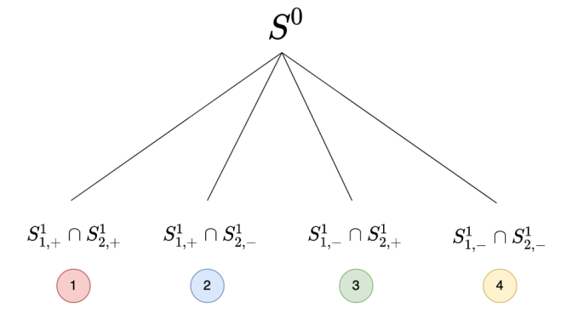

Slide 6





The challenge lies in finding good projection vector a so that samples of different classes are better separated.
Two types of classifiers
pre-select a set of candidate projection vectors, try them out one by one, and select the best one based on a certain criterion.
use some criteria to choose good projection vectors.

Slide 7


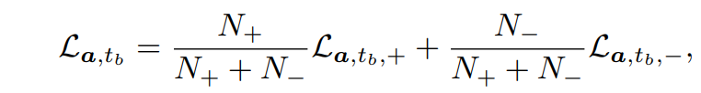
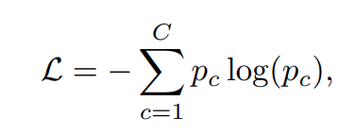
Selection Criterion
Given projection vector
Find the minimum and the maximum of projected values
Partition interval into 16 bins uniformly and use bin boundaries as candidate thresholds.
Evaluate the quality of each split with weighted sum of loss functions
: Entropy value

Slide 8
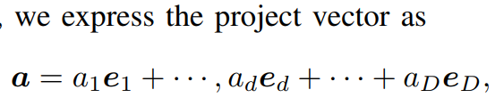


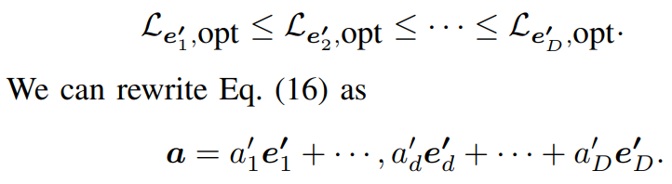
Probabilistic Selection
We adopt a probabilistic mechanism to select one or more multiple good projection vectors.
Evaluate the discriminant power of by setting and following the procedure above
Re-order the basis vectors

Slide 9
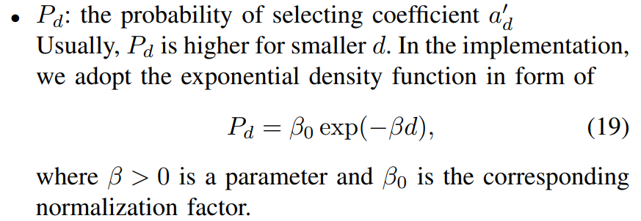
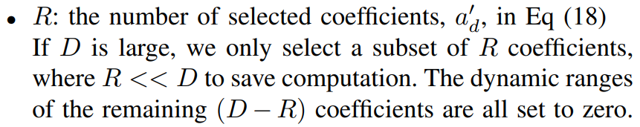
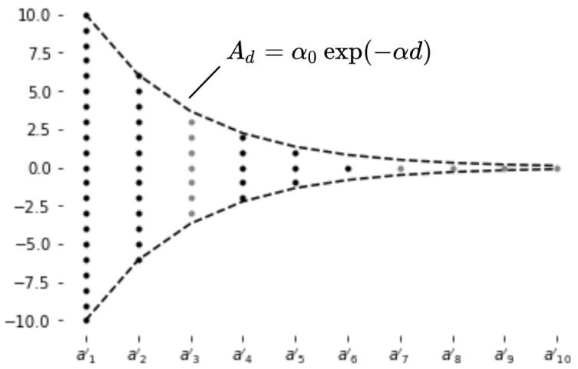
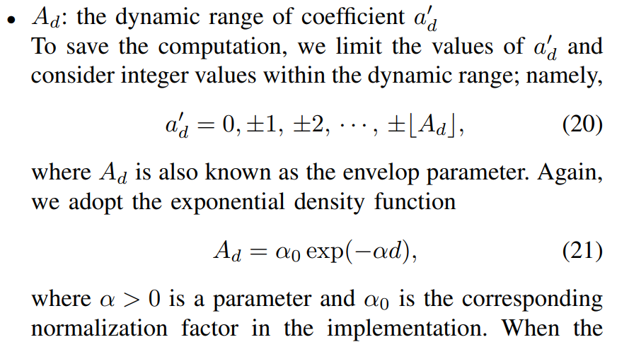

Notes:
Fig. 2. Illustration of the probabilistic selection process, where the envelop function Ad that provides a bound on the magnitude of coefficients a 0 d in the orientation vector. The dimensions with black dots are selected dimensions, and dots in one vertical line are integers for selection for each dimension. In this example, the selected dimensions are a 0 1 , a 0 2 , a 0 4 , a 0 5 and a 0 6 . For each trial, we select one black dot per vertical line to form an orientation vector. The search can be done exhaustively or randomly with the uniform distribution.

Slide 10

Selection of Multiple Projection Vectors
We often result in getting multiple effective projection vectors
The corresponding tow hyperplanes have a small angle between them
we choose the projection vector that has the smallest cost as the first one.
Next, we choose the second one that minimizes its absolute cosine similarity value with the first one.
repeat the same process by minimizing the maximum cosine similarities with the first two, etc.
The iterative mini-max optimization process can be terminated by a pre-defined threshold value

Slide 11
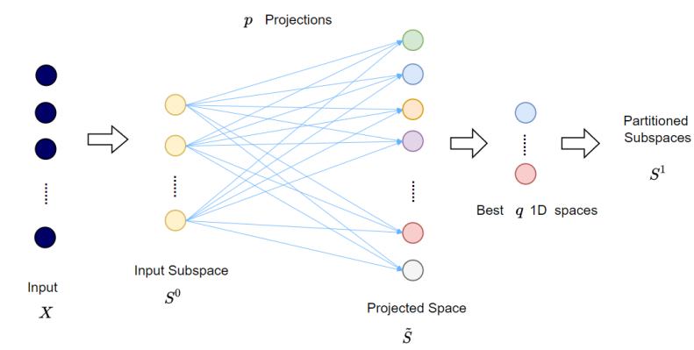
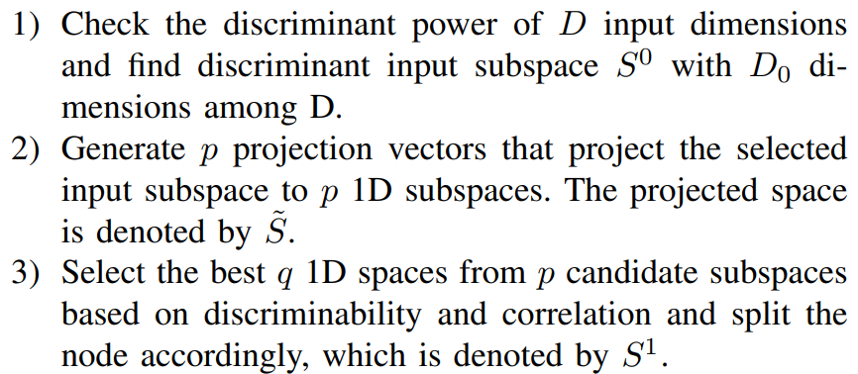
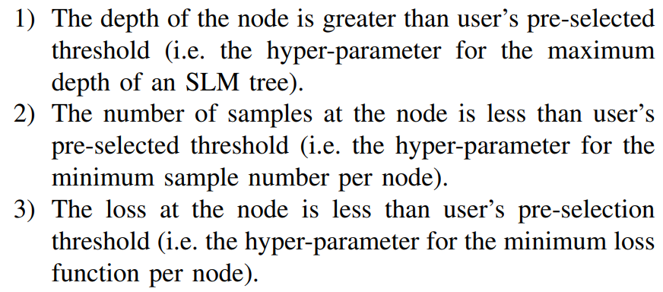
SLM Tree Construction
Three steps to avoid over fitting :

